Slide 1
DA 250 / MDA 710 FINAL: NETFLIX SENTIMENT ANALYSIS
ARI BAZIGOS, CARTER EKBERG, HUNTER LUCKOW, TYLER WELSH

Slide 2

Overview
Significance and Objectives
Data Preprocessing
Exploratory Analysis
Topic Modeling
Machine Learning

Slide 3
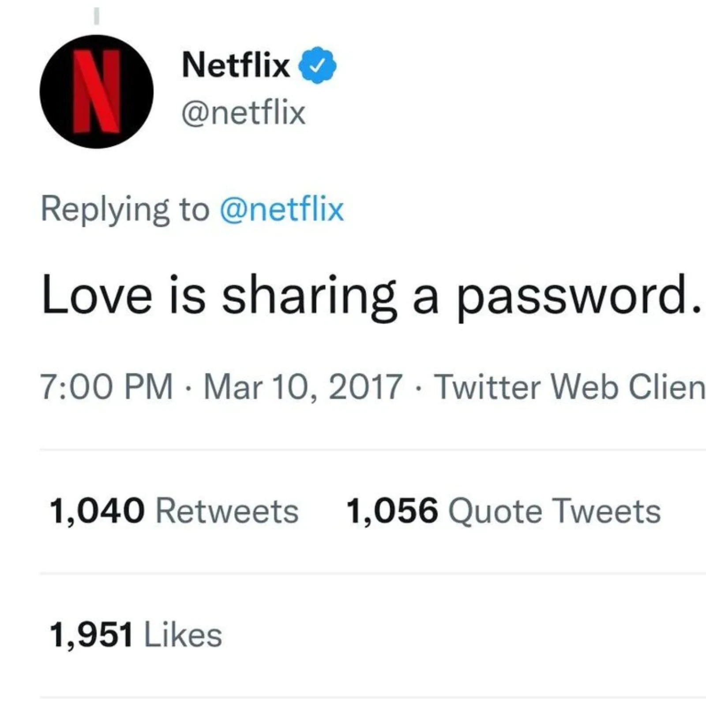
Project Objectives
Use tweets regarding Netflix to calculate consumer sentiment
Observe whether stock price during the dip of 4/19/22 had an effect on tweet sentiment
Utilize Topic Modeling to group tweets into different categories

Slide 4
Project Significance
Netflix recently had the worst quarter in its history
First time ever they lost more subscribers than gained
Company stakeholders may begin to predict company sentiment from external sources.
This may assist in public relations, customer satisfaction, and shareholder comfort.
If the company can gain a sense of what the masses are saying about the company via social media, they can better structure their business and applications to satisfy various parties.
Not only applicable to Twitter data, may also be applicable to other social media platforms.

Slide 5


Data Sources

Slide 6
DATA PRE-PROCESSING AND DATA FRAME CONSTRUCTION

Slide 7
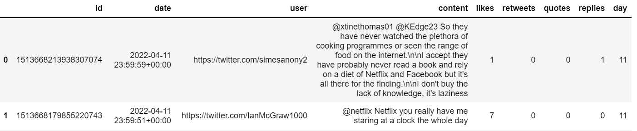
Loading Tweets
snscrape using keyword “Netflix”
2000 tweets per day from April 11 - April 22
Created a .csv file for each day
Loaded all files into DataFrame below

Slide 8
EXPLORATORY ANALYSIS

Slide 9
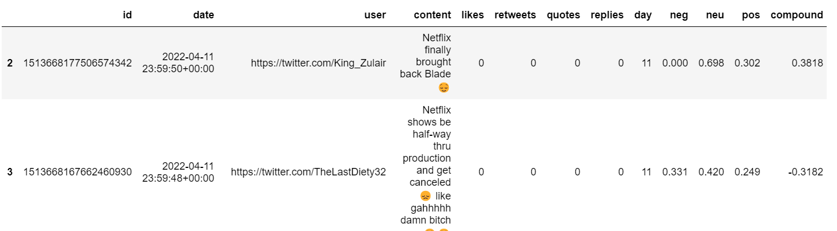
Calculating Sentiment Scores
Applied VaderSentiment to calculate sentiment scores
Each tweet given neg, pos, neu, and compound score
Added scores to our DataFrame

Slide 10
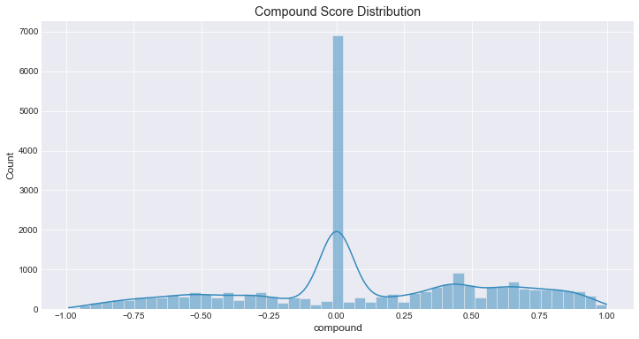
Removing Compound Scores of 0
Removed because no net positive or negative with a compound score = 0.
Felt that these tweets would not be beneficial to our algorithms
Originally 24,000 tweets
After removal, approximately 17,000 tweets

Slide 11
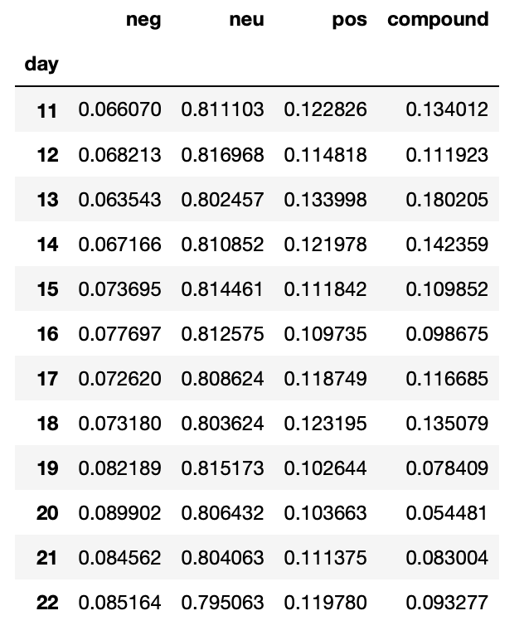
Sentiment Scores by Day
Grouped by “day” to calculate mean scores for each day
Now we can see a trend in scores over time
Negative score stands out as we see an increasing trend.

Slide 12

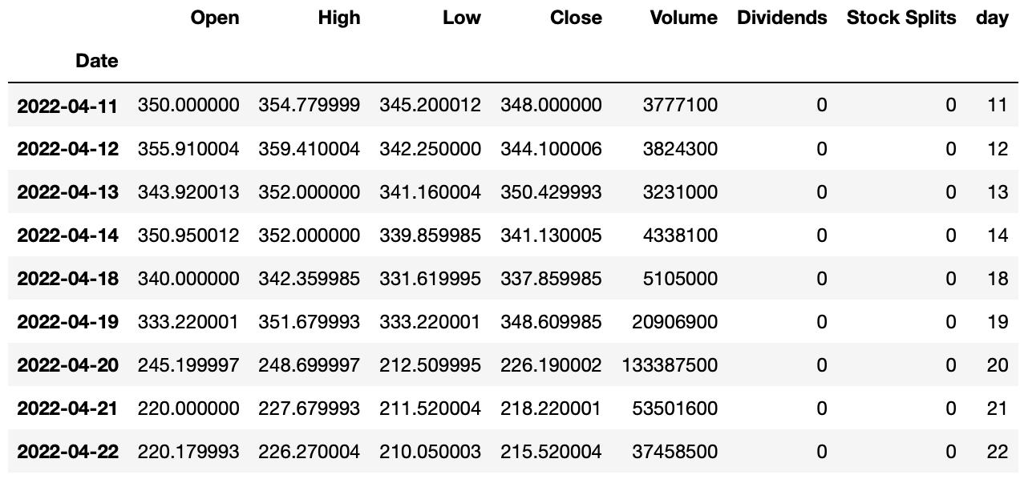
Netflix Stock
We then imported Netflix stock data from yahoo finance for the same date range

Slide 13
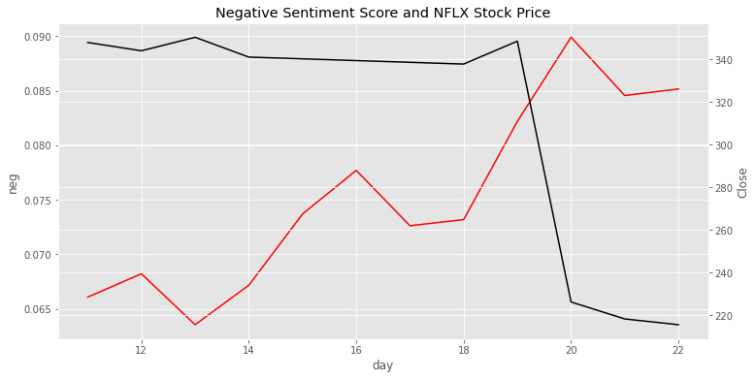

Slide 14
TOPIC MODELING

Slide 15
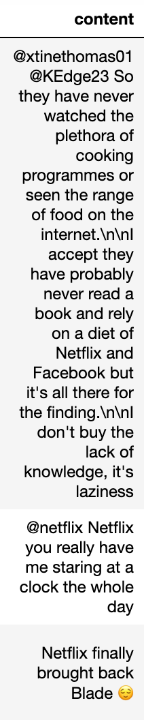
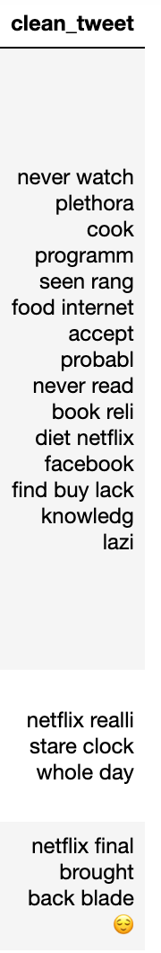
Cleaning Tweets
Before Topic Modeling, need to “clean” text
Remove hyperlinks, emojis, usernames, and punctuation.
We utilized the nltk and re libraries
Also some written functions found online

Slide 16
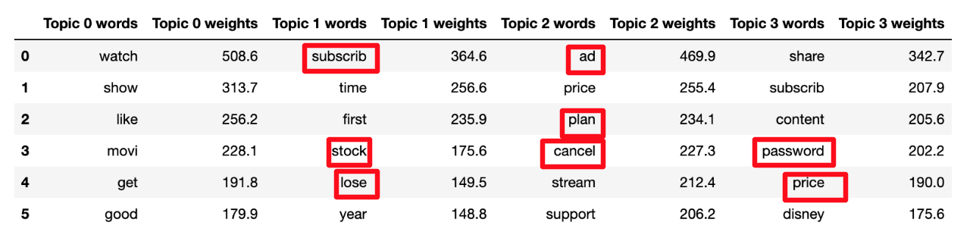
Implementing Topic Modeling
Imported Topic Modeling Algorithm “LatentDirichletAllocation”
Clusters words frequently found in individual tweets.
Made “Netflix” a stop word (cannot be a word in a topic)
Set cluster frequency minimum to 20 instances
Set number of Topics to 4, and cluster size to 6.

Slide 17
MACHINE LEARNING PREDICTIVE MODELS

Slide 18
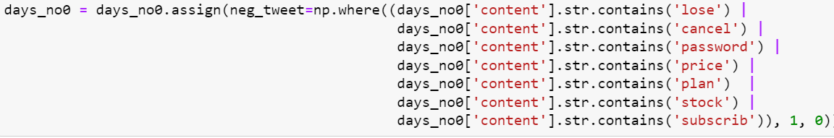
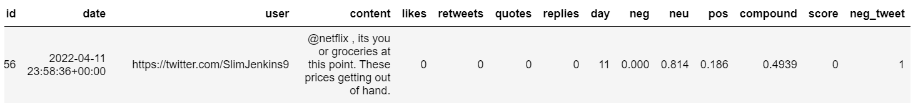
Constructing “neg_tweet” Variable
Used chosen words from our Topic Modeling to flag in tweets
If these words are in a tweet, we flag it as a “negative tweet”

Slide 19
Further Processing
Chose 4 features and target column.
4 features include “neg”, “neu”, “pos”, and “neg_tweet” columns.
Target is “score” column
Target column is based off of negative and positive compound scores.
Since scores are based on compound values, we removed the compound feature column as it would add too much bias to the models.
Now we are ready to start developing our models.

Slide 20
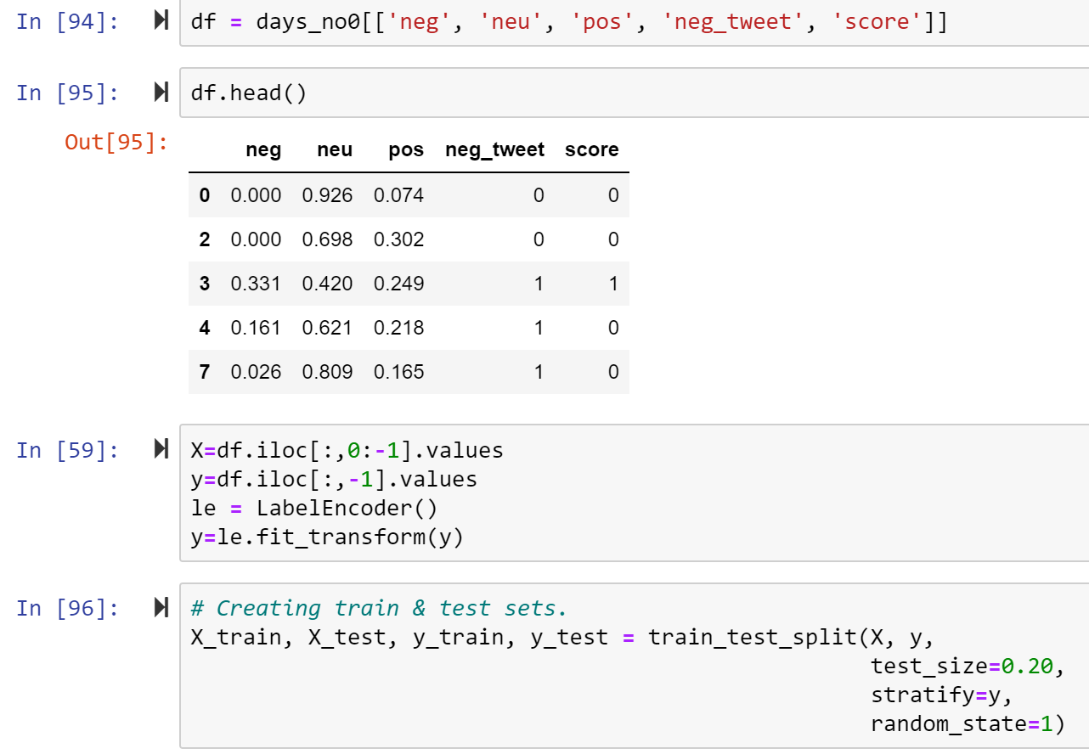
Developing Train and Test Sets
Created dataframe with features and target.
Assigning feature columns to X and target column to y.
Using sklearn train test split to develop train and test sets.

Slide 21
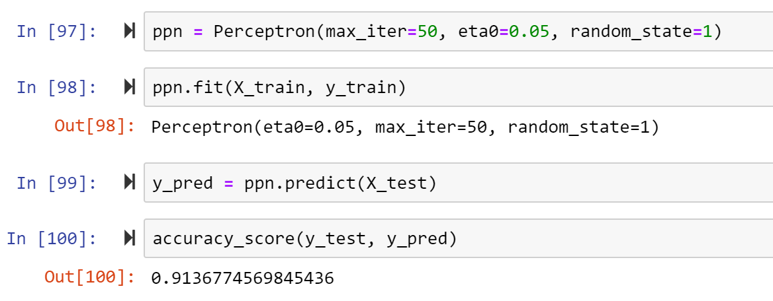
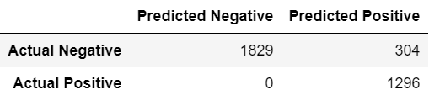
Perceptron
Perceptron model with 50 iterations through the data.
Accurately predicted score 91.4% of the time.
Confusion Matrix

Slide 22
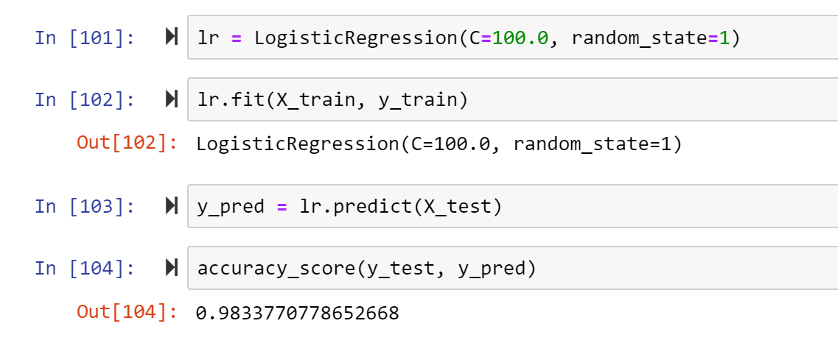
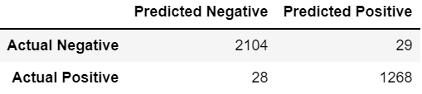
Logistic Regression
Obtained accuracy of 98.3% using Logistic Regression
Confusion Matrix

Slide 23
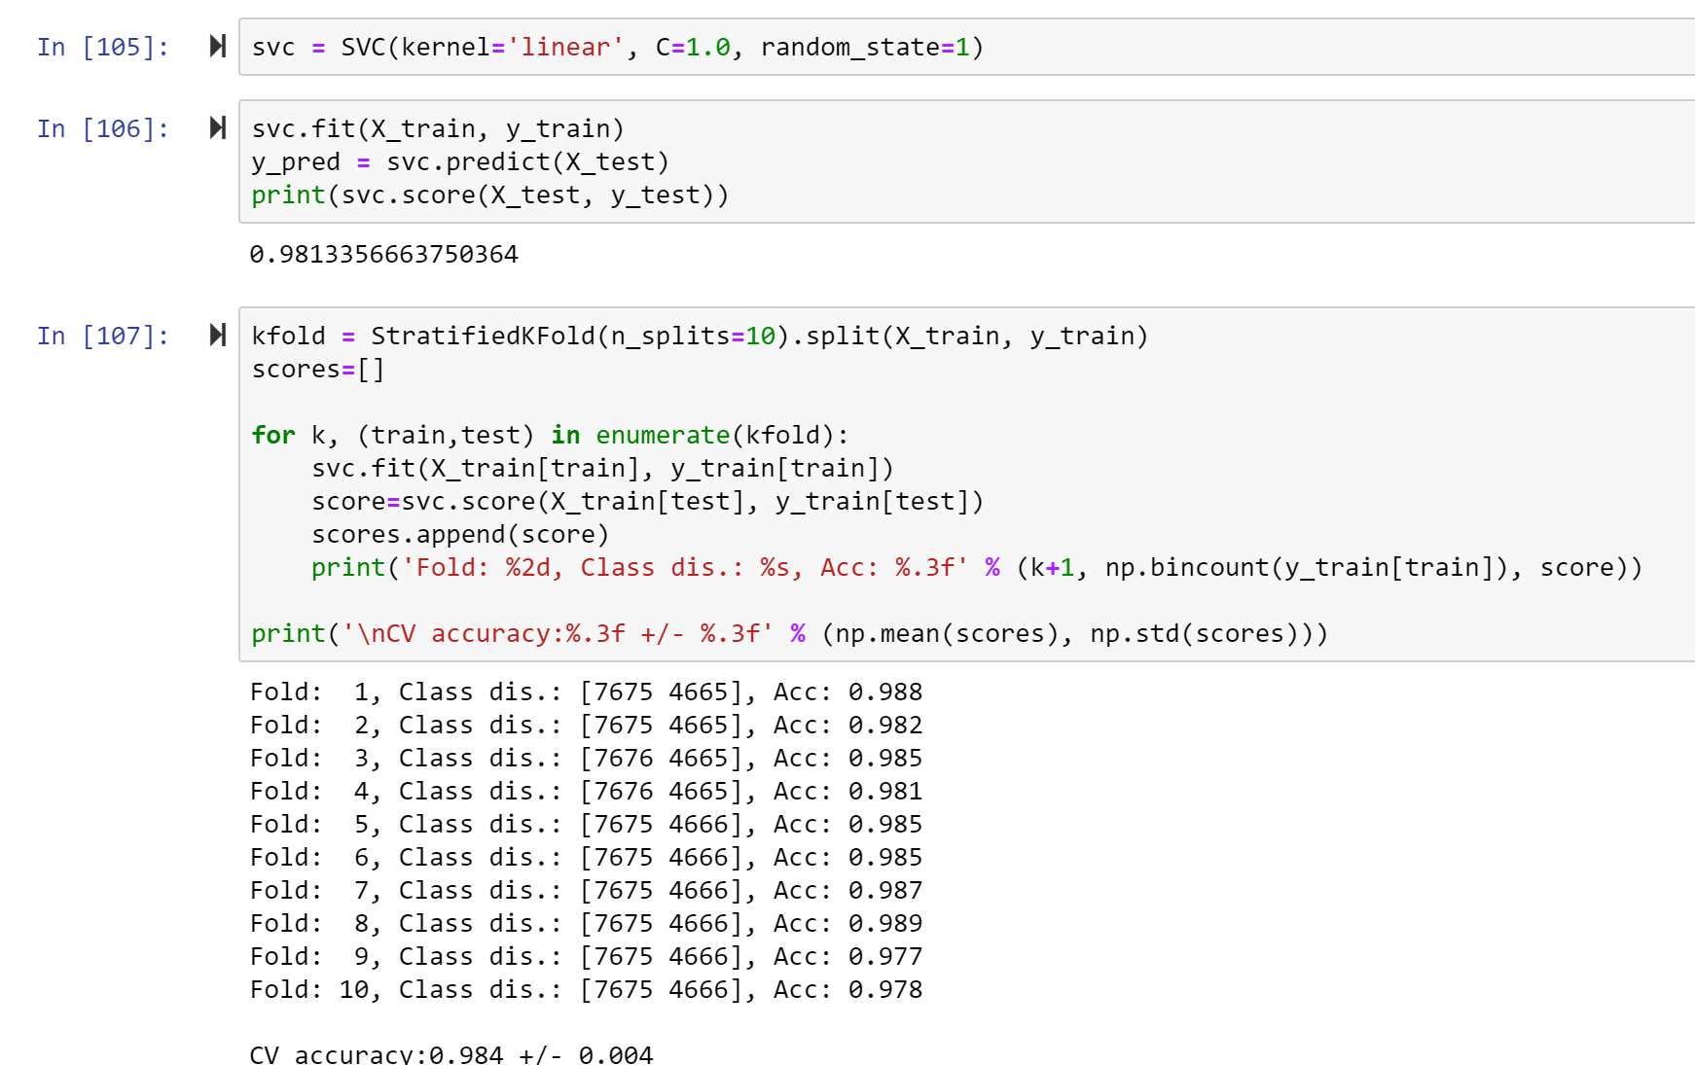
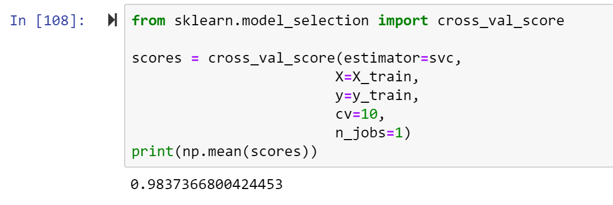
SVM with Cross Validation
Mean cross validation score of 98.4% with a standard deviation of 0.4%.

Slide 24
Conclusions
Using Sentiment Analysis and Topic Modeling, we were able to effectively predict whether tweets would have a positive or negative score.
Topic Modeling allowed us to choose relevant keywords to utilize in our Machine Learning models.
The combination of chosen keywords by humans and calculated sentiment scores allowed our models to predict accurately.
With help from Machine Learning, companies could enhance their customer and stakeholder satisfaction, if able to effectively predict overall market sentiment.

Slide 25
REFERENCES
Investigate.ai
https://investigate.ai/bloomberg-tweet-topics/scrape-tweets-from-presidential-primary-candidates/
Snscrape
https://urldefense.com/v3/__https://medium.datadriveninvestor.com/how-to-build-a-twitter-scraping-app-with-python-b3fc069a19c6*5Cn__;JQ!!DeIc-uvKXH9G!5T9CbaEqjUZdNgpKYalRx5XoU3s8gU2y6eKQSVr-6WS_2Q1CTrH0mP8asxTfF6kBC5BOfhqtUlGIcOeiDS_g2RciMuCe4iTT$
Topic Modeling
https://urldefense.com/v3/__https://ourcodingclub.github.io/tutorials/topic-modelling-python/*5Cn__;JQ!!DeIc-uvKXH9G!5T9CbaEqjUZdNgpKYalRx5XoU3s8gU2y6eKQSVr-6WS_2Q1CTrH0mP8asxTfF6kBC5BOfhqtUlGIcOeiDS_g2RciMjseTSiN$
Python Machine Learning (Sebastian Raschka)

Slide 26
THANK YOU

